Slide 1
NICU SMART APP
Aniruddha, Neil, Parthiv, Sai Praveen and Vetri
GUYS on FHIR
12/09/2016

Slide 2
Introduction
Problem Statement
Newborns in an incubator are constantly being disturbed which disrupts their sleeping pattern.
The parents of new-borns(who are in NICU) cannot always get access to their babies. This can generate a mental depression.

Slide 3
Motive
Remote monitoring of a new-born inside an incubator without disturbing their sleeping pattern.
The parents of new-born will get 24/7 video feedback of their babies.
Improve patient care through SMART apps

Slide 4
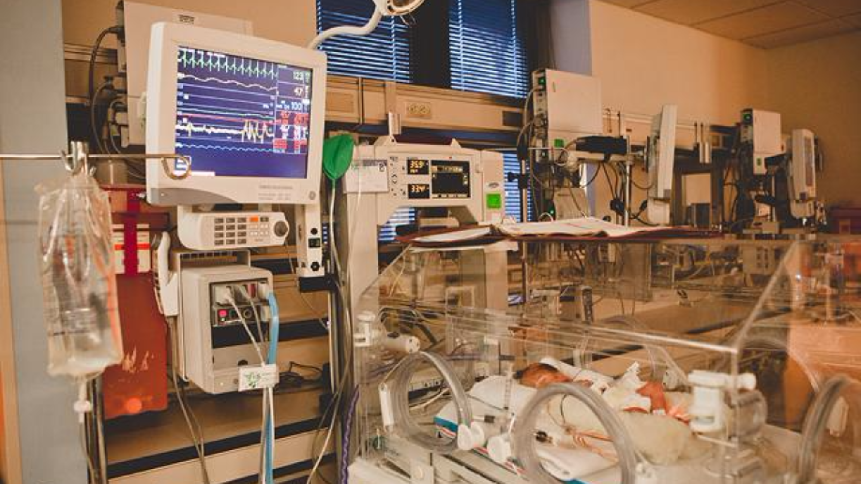
Neonatal Intensive Care Unit

Slide 5







NICU + FHIR SMART

Slide 6
Technology Stack
SMART on FHIR is a new approach that will enable "plug-in apps" to run natively inside any compliant EHR systems at the point of care
FHIR - a new HL7 standard that creates a RESTful API for EHR data stores
The SMART Platform, an open-source toolkit for embedding apps into EHR workflow.
Twilio Video API - implement multi-party video calling into the web and native mobile applications quickly.
Javascript has been used as our main programming language.

Slide 7
DEMO

Slide 8
Future Scope
Integrate 3rd party APIs – alert service, analyze sleeping patterns
Remote access of data

Slide 9


